Slide 1
How to come to a rational energy policy in Europe
and the world ? F. Wagner IPP Greifswald
1
Many different RES
Scalable sources are the intermittend ones: wind and PV
The experiences of Germany can be extrapolated and generalised

Slide 2
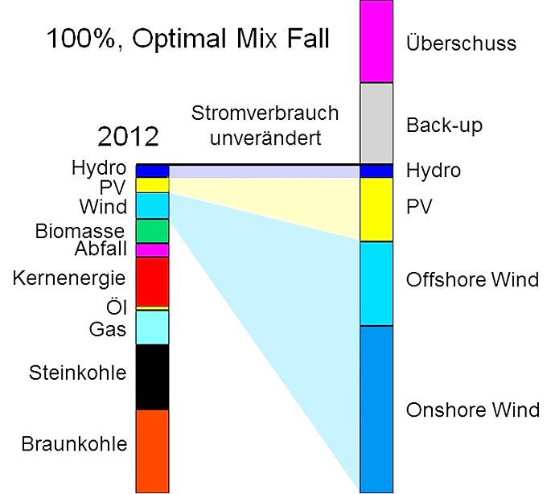
From today to tomorrow“
2
100%, optimal mix case
level of
consumption
unchanged
500 TWh

Slide 3
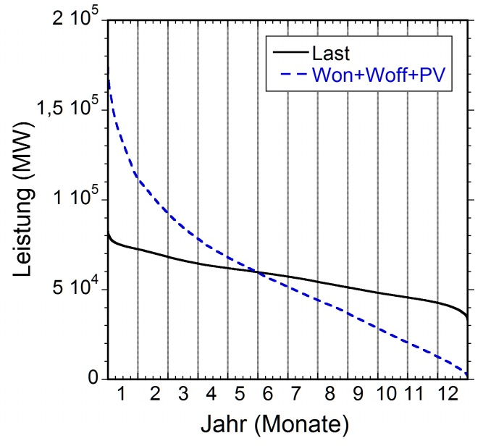
The basic problem of intermittent sources
3
Annual duration curves of load and wind+PV under optimal mix
load
power (MW)
time (months)

Slide 4
Major Results (for Germany)
4
How much power has to be installed? Enough to serve Europe in good days The remaining need for back-up power? 88% The extent of surplus energy? Formally enough to serve Poland Dimensioning storage? For a 100% case: 33 TWh The dynamics of the back-up system? From 0 up to the load; strong gradients The conditions for DSM (demand-side management)? Cheap electricity prices during the day | The amount of CO2 reduction? Not to the level of France, Sweden... Conditions of a 100% supply by RES? Use of biogas (e.g. 40 TWh) and savings (to 30%) What could be a reasonable share by intermittent RES? 40% The benefits of an EU-wide use of RES? Effects in the order of 20-30% Costs to implement RES? high
Similar results for
other EU countries

Slide 5
Storage
5
Need from back-up depending on the storage capacity

Slide 6
Storage
6
Need from back-up depending on the storage capacity
Alternative concept
from study for Italy
F. Romanelli
RES with increased PV
Reduced storage
(0.5 – 1 TWh)
Base-load supply:
10-15 GW

Slide 7
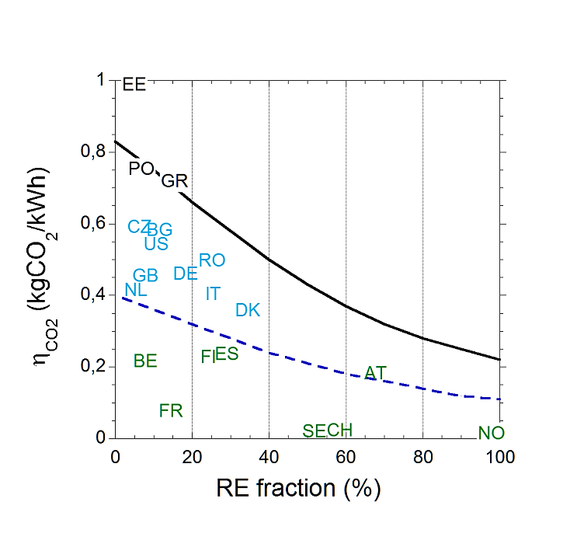
Specific CO2 emission
7
Countries with hydro + nuclear are already where others would like to be in 2050

Slide 8
Specific CO2 emission
8

Slide 9
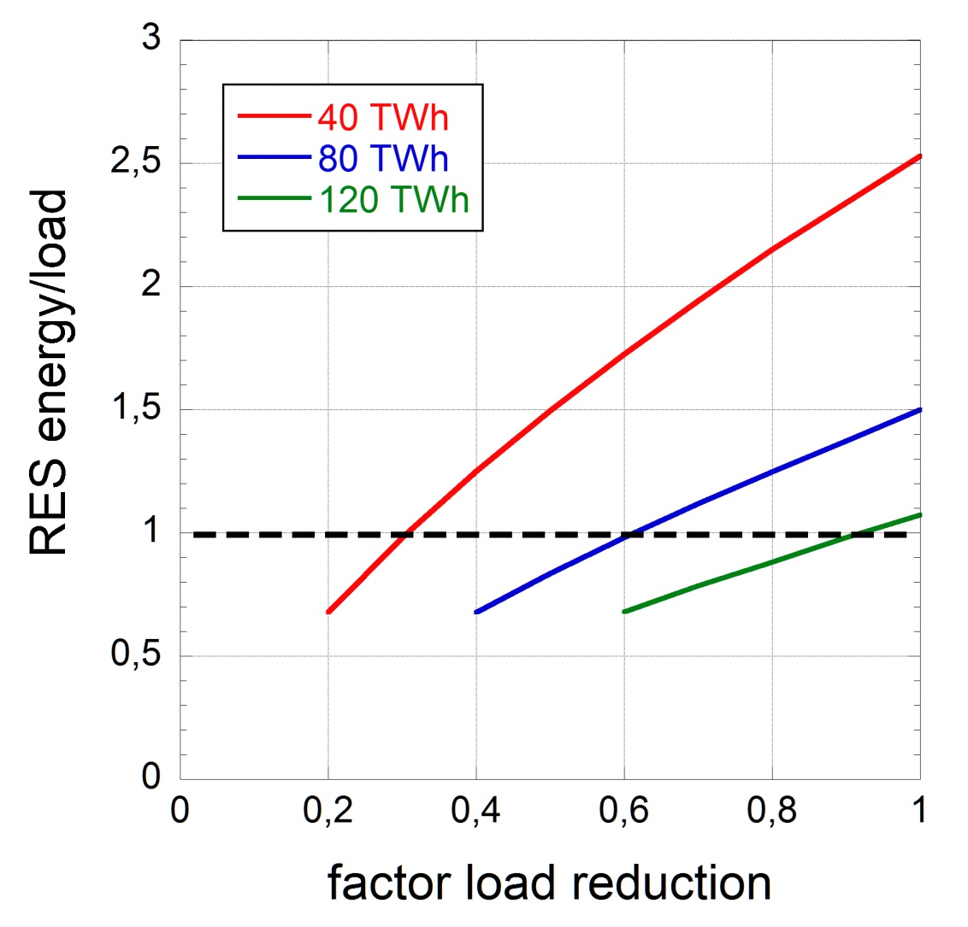
Conditions of a 100% supply by RES
9
Main knobs: savings/efficiency + use of biomass
Minor knobs: decrease of population, import (depatchable power?)
factor of demand reduction

Slide 10
Benefit from an EU-wide RES field
10
Annual duration curves for German RES field (dashed) and EU-wide RES field

Slide 11
The benefit
11
the back-up energy is reduced by 24%,
the maximal back-up power by 9%,
the maximal surplus power by 15%,
the maximal grid power by 7%,
the typical grid fluctuation level by 35%
the maximal storage capacity by 28%

Slide 12
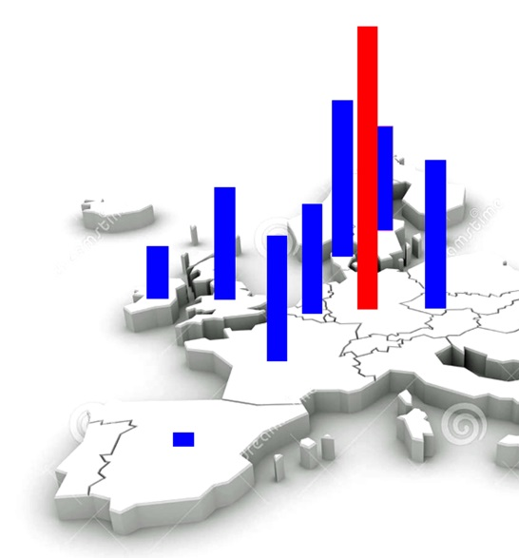
The structure of the EU-wind field
12
normalised surplus
and
„useful“ surplus
wind
correlation
coefficient
100%
UK
Spain
Ireland
Belgium
France
Germany
Denmark
Czech Rep.

Slide 13
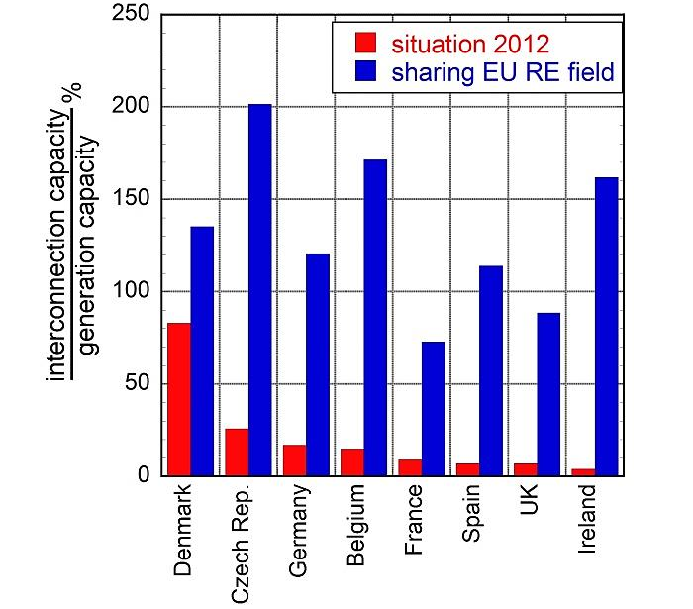
Interconnector capacity
13

Slide 14
Development costs
14
Source: F. Wagner
Finadvice

Slide 15
Conclusions
15
Large installations: high costs
Use of landscape
12% savings in back-up
Uneconomic use of back-up (little operation, high maintenance costs)
Technology for large-scale storage not developed
Storage operation will not be economic
Large price difference between primary and secondary electricity
DMS will force the weekends to be used for economic purposes
Nuclear power is more efficient to reduce CO2 emission
Possibly, 40% of intermittent electricity tolerable: The rest?

